Slide 1
Time Series Analysis
AR, MA and ARIMA Models
Sourav Karmakar
souravkarmakar29@gmail.com

Slide 2
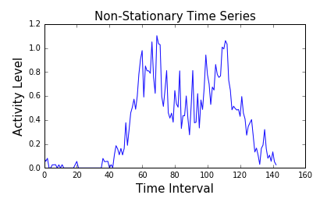
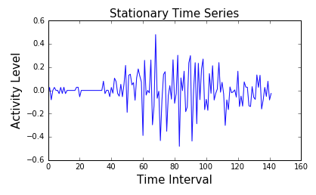
Stationarity in Time Series
What is Stationarity
In the most intuitive sense, stationarity means that the statistical property (mainly mean and variance) of a process generating time series do not change over time.
It does not mean that the series does not change over time, just that the way it changes does not itself change over time.
Why is it important
Stationary data are much more simpler to analyse and model. Hence, for time series analysis and modelling if a series in non-stationary we make them stationary by differencing.

Slide 3
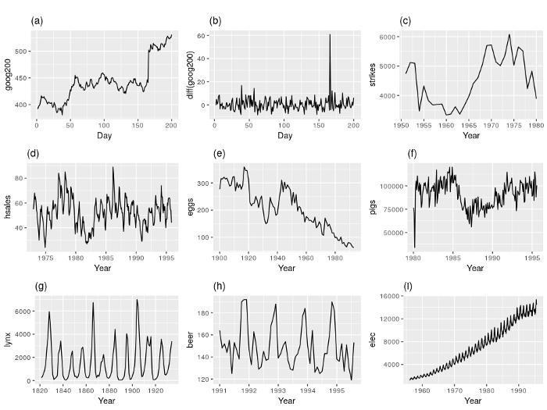
Detecting the stationarity in Time Series
Visualization
Google stock price for 200 consecutive days;
Daily change in the Google stock price for 200 consecutive days;
Annual number of strikes in the US;
Monthly sales of new one-family houses sold in the US;
Annual price of a dozen eggs in the US (constant dollars);
Monthly total of pigs slaughtered in Victoria, Australia;
Annual total of lynx trapped in the McKenzie River district of north-west Canada;
Monthly Australian beer production;
Monthly Australian electricity production.

Slide 4
Detecting the stationarity in Time Series
Statistical Tests
Sometimes identifying the stationarity of a time series can’t be done just by visualizing it.
Hence, we need to perform Statistical Tests in order to check if the time series is stationary.
The Dickey Fuller Tests
The Dickey-Fuller test was the first statistical test developed to test the null hypothesis that a unit root is present in an autoregressive model of a given time series, and that the process is thus not stationary. The original test treats the case of a simple lag-1 AR model.
The KPSS Tests
Another prominent test for the presence of a unit root is the KPSS test. [Kwiatkowski et al, 1992] Conversely to the Dickey-Fuller family of tests, the null hypothesis assumes stationarity around a mean or a linear trend, while the alternative is the presence of a unit root.
There are other tests to determine the stationarity of time series models.

Slide 5
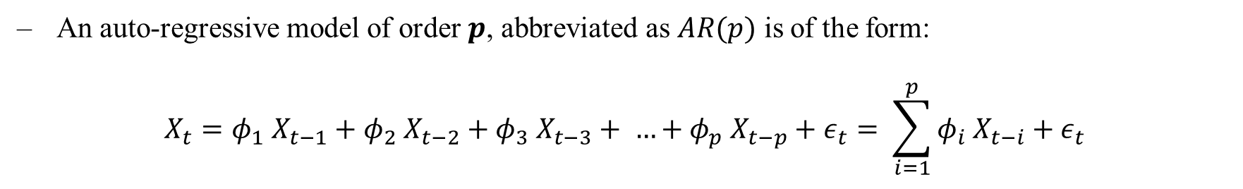
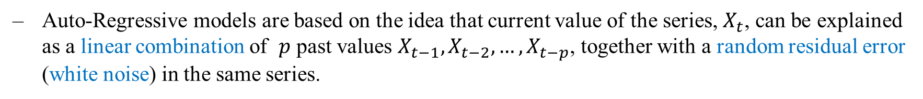
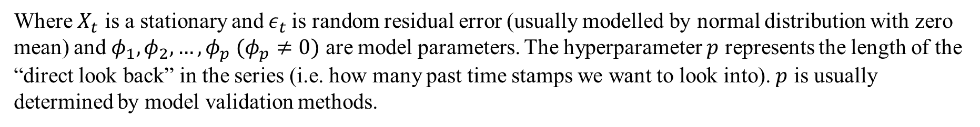
Auto-Regressive Models
Intuition
Auto-Regressive models are based on the idea that current value of the series, $X_{t}$, can be explained as a linear combination of $p$ past values $X_{t−1}, X_{t−2}, …, X_{t−p}$, together with a random residual error (white noise) in the same series.
Definition
An auto-regressive model of order $p$, abbreviated as $AR(p)$ is of the form:
$$X_{t}=φ_{1} X_{t−1}+φ_{2} X_{t−2}+φ_{3} X_{t−3}+ …+φ_{p} X_{t−p}+ε_{t}= \sum_{i=1}^{p}{φ_{i} X_{t−i}+ε_{t}}$$
Where $X_{t}$ is a stationary and $ε_{t}$is random residual error (usually modelled by normal distribution with zero mean) and $φ_{1}, φ_{2}, …, φ_{p} (φ_{p}≠0)$ are model parameters. The hyperparameter $p$ represents the length of the “direct look back” in the series (i.e. how many past time stamps we want to look into). $p$ is usually determined by model validation methods.

Slide 6
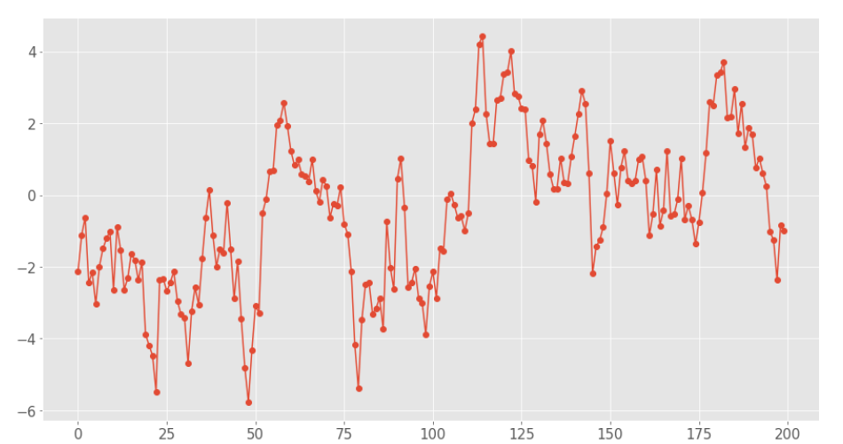
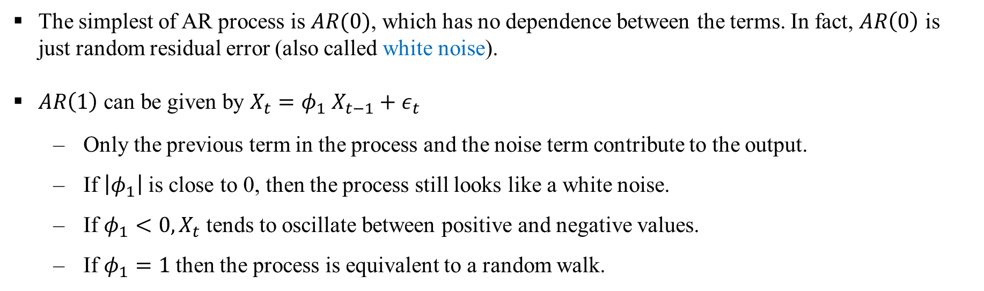
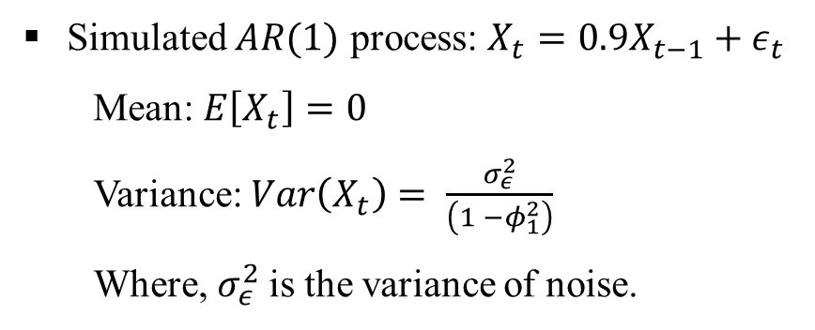
Auto-Regressive Models
The simplest of AR process is $AR(0)$, which has no dependence between the terms. In fact, $AR\left(0\right)$ is just random residual error (also called white noise).
$AR\left(1\right)$ can be given by $X_{t}=φ_{1} X_{t−1}+ε_{t}$
Only the previous term in the process and the noise term contribute to the output.
If $\left|φ_{1}\right|$ is close to 0, then the process still looks like a white noise.
If $φ_{1}<0, X_{t}$ tends to oscillate between positive and negative values.
If $φ_{1}=1$ then the process is equivalent to a random walk.
Simulated $AR(1)$ process: $X_{t}={0.9X}_{t−1}+ε_{t}$
Mean: $E\left[X_{t}\right]=0$
Variance: $Var\left(X_{t}\right)= \frac{σ_{ε}^{2}}{\left(1 −φ_{1}^{2}\right)}$
Where, $σ_{ε}^{2}$is the variance of noise.

Slide 7
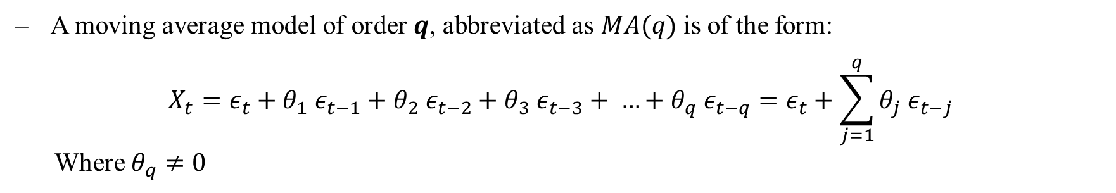
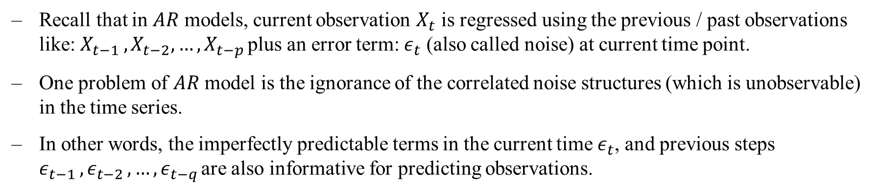
Moving Average (MA) Models
The name might be misleading but moving average models should not be confused with the moving average smoothing.
Motivation
Recall that in $AR$ models, current observation $X_{t}$ is regressed using the previous / past observations like: $X_{t−1 },X_{t−2}, …,X_{t−p }$plus an error term: $ε_{t}$ (also called noise) at current time point.
One problem of $AR$ model is the ignorance of the correlated noise structures (which is unobservable) in the time series.
In other words, the imperfectly predictable terms in the current time $ε_{t}$, and previous steps $ε_{t−1 },ε_{t−2 }, …,ε_{t−q }$are also informative for predicting observations.
Definition
A moving average model of order $q$, abbreviated as $MA(q)$ is of the form:
$$X_{t}={ε_{t}+θ}_{1} ε_{t−1}+θ_{2} ε_{t−2}+θ_{3} ε_{t−3}+ …+θ_{q} ε_{t−q}=ε_{t}+\sum_{j=1}^{q}{θ_{j} ε_{t−j}}$$
Where $θ_{q}≠0$

Slide 8
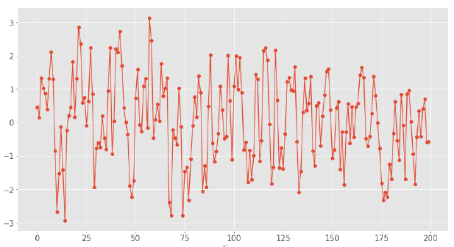
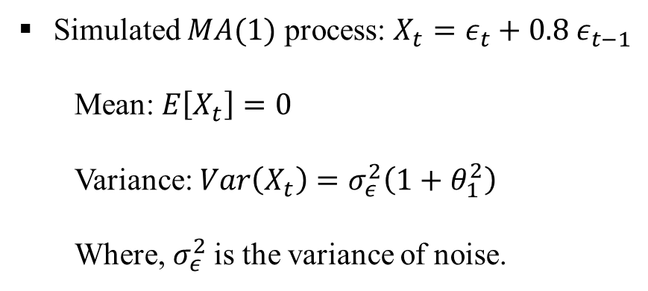
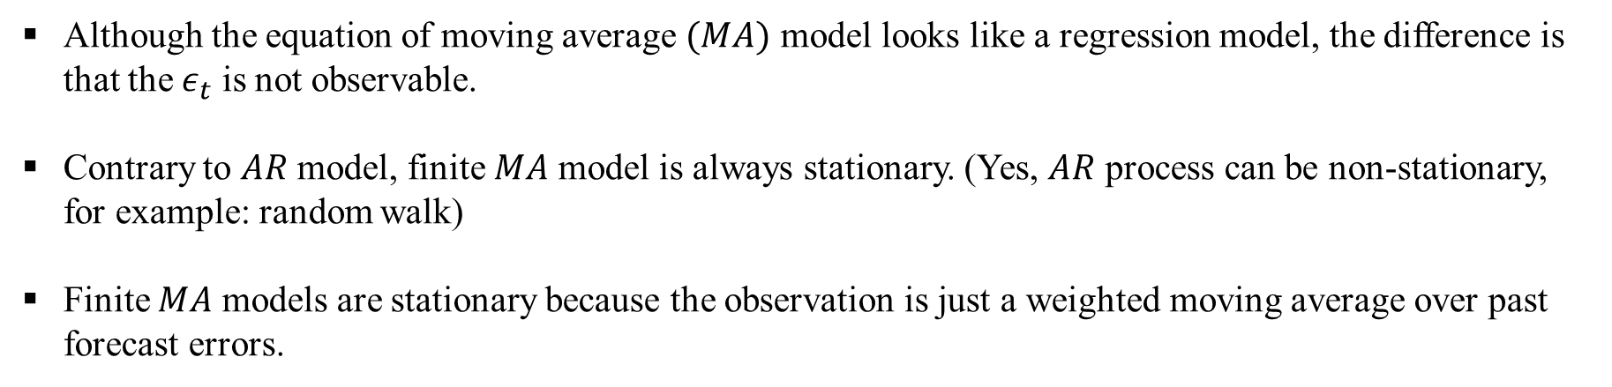
Moving Average (MA) Models
Although the equation of moving average $(MA)$ model looks like a regression model, the difference is that the $ε_{t}$ is not observable.
Contrary to $AR$ model, finite $MA$ model is always stationary. (Yes, $AR$ process can be non-stationary, for example: random walk)
Finite $MA$ models are stationary because the observation is just a weighted moving average over past forecast errors.
Simulated $MA(1)$ process: $X_{t}=ε_{t}+0.8 ε_{t−1}$
Mean: $E\left[X_{t}\right]=0$
Variance: $Var\left(X_{t}\right)=σ_{ε}^{2}\left(1+θ_{1}^{2}\right)$
Where, $σ_{ε}^{2}$is the variance of noise.

Slide 9
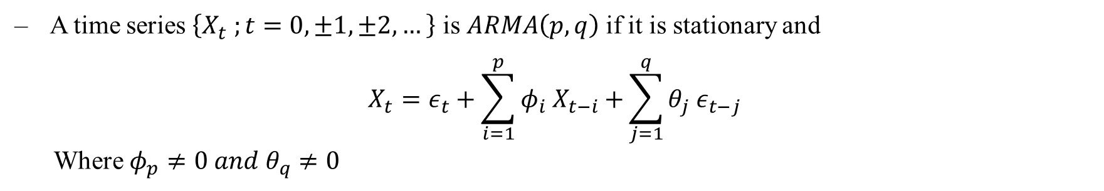
ARMA Models
Intuition
Auto-Regressive and Moving Average models can be combined together to form ARMA models.
Definition
A time series $\left\{X_{t} ;t=0, ±1, ±2, …\right\}$ is $ARMA\left(p,q\right)$if it is stationary and
$$X_{t}=ε_{t}+\sum_{i=1}^{p}{φ_{i} X_{t−i}+}\sum_{j=1}^{q}{θ_{j} ε_{t−j}}$$
Where ${φ_{p}≠0 and θ}_{q}≠0$
One limitation of ARMA models is the stationarity condition.
In many situations, time series can be thought of as being composed of two components, a non-stationary trend series and a zero-mean stationary series. The strategies to stationarize time series models are:
Detrending: Subtract with an estimate for trend and deal with residual.
Differencing: Take the difference of the time series, often those are stationary.

Slide 10
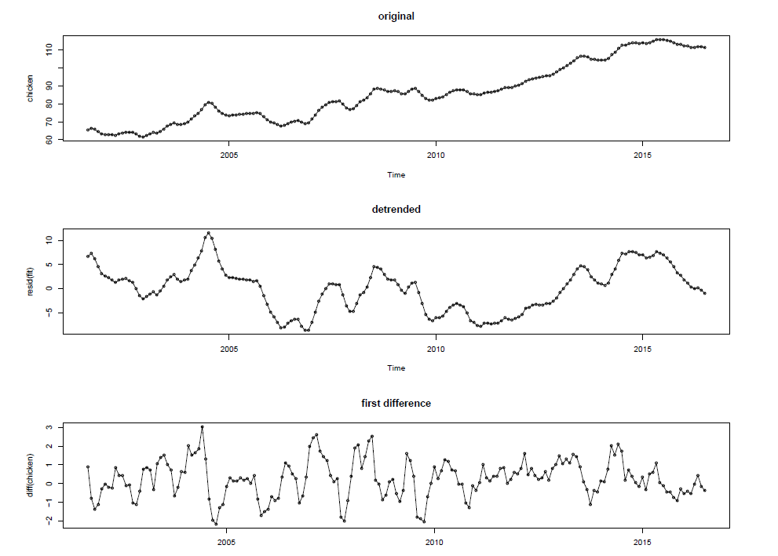
Detrending and Differencing

Slide 11
ARIMA Model
ARIMA is an acronym that stands for Auto-Regressive Integrated Moving Average.
Specifically,
AR Autoregression. A model that uses the dependent relationship between an observation and some number of lagged observations.
I Integrated. The use of differencing of raw observations in order to make the time series stationary.
MA Moving Average. A model that uses the dependency between an observation and a residual error from a moving average model applied to lagged observations.
Each of these components are explicitly specified in the model as a parameter.
Note that AR and MA are two widely used linear models that work on stationary time series, and I is a preprocessing procedure to “stationarize” time series if needed.

Slide 12
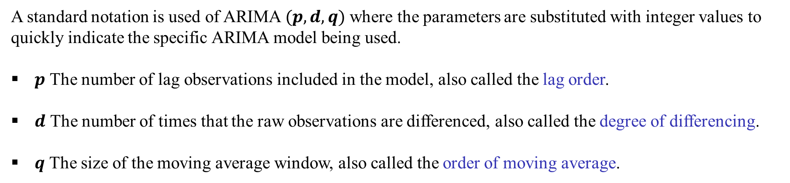
ARIMA Model
A standard notation is used of ARIMA $(p, d, q)$ where the parameters are substituted with integer values to quickly indicate the specific ARIMA model being used.
$p$ The number of lag observations included in the model, also called the lag order.
$d$ The number of times that the raw observations are differenced, also called the degree of differencing.
$q$ The size of the moving average window, also called the order of moving average.
A value of 0 can be used for a parameter, which indicates to not use that element of the model.
In other words, ARIMA model can be configured to perform the function of an ARMA model, and even a simple AR, I, or MA model.

Slide 13
Thank You

